Slide 1
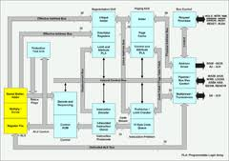

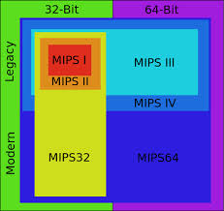
Advance Computer Architecture
Presented By:
Zunera Altaf
Ambreen Younas
Sehrish Asif
Wajeeha

Slide 2
Advance Computer Architecture
COMPARISON BETWEEN
RICS v/s CISC
BY
Yi Gao
Shilang Tang
Zhongli Ding

Slide 3
Agenda
1
Introduction
2
History
RISC v/s CISC
3
The Benchmarks
4
Who Wins?
Benchmark Selection
Benchmark Compilation
Data Collection
Instruction Count
Instruction Format and Encoding
Addressing Modes
Data Traffic
Experiments with MIPS 2000 and Intel 80386
Conclusion

Slide 4
Introduction
The debate between CISC & RISC has been going on for a long time and
will likely continue. The difference between RISC and CISC can lays on
many levels, lots of plausible arguments are put forward by both sides
such as.
Code density
Transistor counts
Memory bottlenecks
Compiler
Decode complexity etc.

Slide 5
Introduction(Cont.)
This paper intends to compare these two different ideas in detail, their distinct
characters, their possible specific application domains, their current scope and
their future development to the CPU design.

Slide 6
Introduction(Cont.)
To Explain the difference between them experiment mainly based on the
MIPS R2000 and Intel 80386 instruction sets.
MIPS R2000 is a typical product of pure RISC
Intel 80386 is a typical kind of pure CISC chip

Slide 7
History of Risc & Cisc
The IBM 360 system, created in 1964, was probably the first modern
processor system.
Micro-coded control.
Desire to reduce semantic gap.
Execute fewer instructions and thus would have better performance.
Provide hardware flexibility.
Instructions with different sizes and execution cycles, which makes CISC instructions harder to pipeline.

Slide 8
History (cont.)
In the middle of 70's people began to doubt the design philosophy behind
CISC with:
Complex instructions sets.
Decoding and execution of such instructions were complicated and time-consuming.
Overhead brought by them slowed down the execution of those more frequently used simple instructions.
All these may finally decrease the performance

Slide 9
History (cont.)
Based on previous (slide) observation, RISC chips evolved around the mid 1970 as a reaction at CISC chips.
In 70's, John Cocke at IBM's T.J Watson Research Center provided the fundamental concepts of RISC.

Slide 10
History (cont.)
This chip contained many traits a later RISC chip should have:
Few instructions.
Fix sized instructions in a fixed format.
Execution on a single cycle of a processor.
Load / Store architecture.
Hard-wired control
superscalar and speculation is possible easier.
They realized that RISC promised higher performance, less cost and faster
design time.

Slide 11
History (cont.)
The design philosophies behind RISC chip are "make common case faster“ and "simple is best“.
In a CISC chip, many very complex instructions never or seldom used, but they make the control unit extremely complex and thus have a high control unit delay.
As researchers continued into RISC during the 1970's and 1980's it became clear that the factors described resulted in a speed increase over CISC designs.

Slide 12
History (cont.)
With the fleeting of time, the battle over RISC and CISC became blur, though pure RISC machine may outperform pure CISC machine, but both of each have some bad faces which interfere their further improvement of performance.
In 90's, the trend is migrating toward each other, RISC machines may adopt some traits from CISC, while CISC may also do it vice versa.

Slide 13
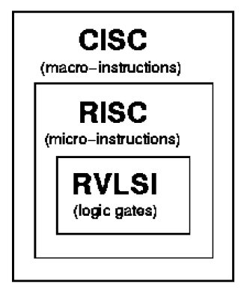
History (cont.)
An example is Intel microprocessors,
though they use a CISC instruction
set and are considered CISC chips,
the internal architecture has
gradually migrated to RISC.

Slide 14
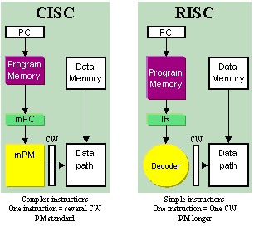
CISC
RISC

Slide 15
Comparison
RISC
Simple primitive instructions and addressing modes.
Instructions generally take more than 1 clock to execute.
Instructions of a variable size.
Instructions interface with memory in multiple mechanisms with complex addressing modes.
No pipelining.
Upward compatibility within a family.
Microcode control.
Work well with simpler compiler.
Richer instruction set, some simple, some very complex.
Instructions execute in one clock cycle.
Uniformed length instructions and fixed instruction format.
Instructions interface with memory via fixed mechanisms.
Pipelining.
Instruction set is orthogonal (little overlapping of instruction functionality)
Hardwired control.
Complexity pushed to the compiler.
CISC

Slide 16
Comparison (Cont.)
Advance CISC
Segmented memory model
Advance RISC
Superscalar and out-of-order execution
Few registers
Crappy floating point performance
Large number of registers
Fast floating point performancef

Slide 17
Middle to 80’s
Non Intel's Machines
Seemed to have a clearly upside, until the appearing of i486, Pentium and now PII, PIII.
Intel's Machines
Still run the old instruction set, but they adopt some RISC Characteristics e.g. one clock execution superscalar operations and lots of registers.
CISC runs faster and faster with a decent floating point performance.
RISC machines added more instructions to their architectures for new data types.
Now, The difference between RISC and CISC is no longer one of instruction sets, but of
the whole chip architecture and system.

Slide 18
Cisc & Risc Processors

Slide 19
CISC & RISC’s Models
CISC
Intel 80x86
Motolora 68K and 680x0
DEC VAX
RISC
IBM RT-PC
IBM RS6000
Intel's i860 and i960,
MIPS R2000 (and so on),
Motorola's 88K,
Motolora/IBM's PowerPc
Sun's SPARC
HP PA-RISC
Experiments with MIPS 2000 and Intel 80386

Slide 20

Intel 80386 Vs Mips r2000

Slide 21
Comparison
MIPS 2000
1. An advanced microprocessor optimized for multitasking operating systems
2. Designed for applications needing very high performance.
3. Its 32-bit registers and data paths support 32-bit addresses and data types
4. 32-bit architecture with 32-bit address space, the 80386 added new addressing modes and additional operations 80386 also added paging support in addition to segmented addressing. Like 80286, the 80386.
6. 80386 has 16 registers 8 of them can be general purpose registers and 8 additional floating point registers.
Intel 80386
1. Design came from the Stanford MIPS project, which stood for Microprocessor without Interlocked Pipeline Stages, and was debatably the first commercial RISC processor.
2. It is a 32-bit processor with an off-chip split cache for instructions and data
3. 32 general purpose integer registers and 16 separate 64-bit floating point registers. The integer pipeline has a depth of 5 and the floating-point pipeline a maximal depth of
4. It has only 2 addressing mode, its opcode is 6 bits, which limits the totally number of instructions and it has one delay slot used for delayed branch.
32-bit machine,
Comparable limitation of hardware
Compiler technology

Slide 22
Summary of 80386 and MIPS R2000 architectures
Components | MIPS R2000 | Intel 80386
Date announced | 1986 | 1985
Instruction size(bits) | 32 | Variable
Address space(size, model) | 32 bits, flat | 32 bits, segmented with paging support
Data alignment | Aligned | No
Data addressing modes | 2 | 11
Protection | Page | Segmented Scheme
Integer registers (number, model, size) | 31 GPR*32 bits | 8 GPR*32 bits, 6 segment registers*16 bits, 2 other * 16 bits
Floating-point format | IEEE 754 single | IEEE 754 single, double, extended

Slide 23
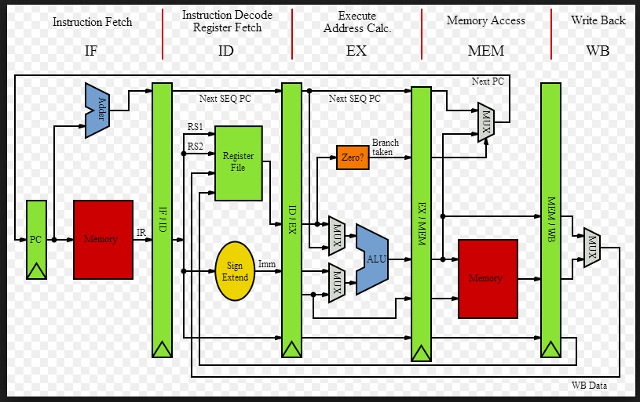
MIPs R2000 ➔ RISC

Slide 24
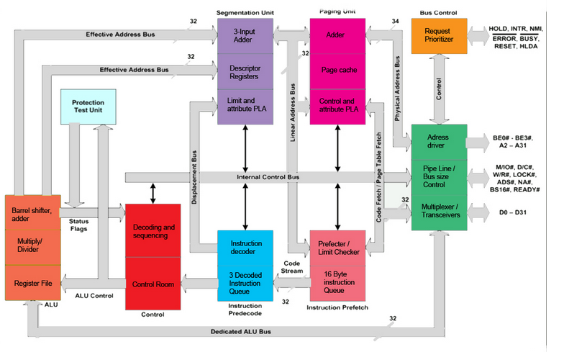
Intel 80386 ➔CISC

Slide 25
Bench marks

Slide 26
Benchmark Selection
We select benchmarks used for comparison carefully; we try to select
benchmarks that can cover as many faces as possible.
The series of benchmarks we selected varies from real programs to some famous one we got from web, and they are all C programs.
Notes:
We select benchmarks used for comparison carefully; we try to select benchmarks that can cover
as many faces as possible. The series of benchmarks we selected varies from real programs to
some famous one we got from web, and they are all C programs.

Slide 27
Integer Benchmark
Test1
Is a suit of programs use for compiler optimization analysis.
Standford
Suite of benchmarks that are relatively short both in program size and execution time.
Poly
Very common and typical real-world integer program.
Includes 7 small programs:
bubble sort,
towers of Hanoi,
the 8 queens problem,
quick sort,
integer matrix multiply,
Perm and Sieve.

Slide 28
Floating-point Benchmarks:
Whetstone
Mix of floating-point and integer arithmetic
Function calls
Array indexing
Var
Corresponding to poly, it is a very common real-world FP program.
Lre
This is a real-world computation intensive program.
Defeat many simple compiler optimizations.
Conditional jumps
Transcendental functions.
It makes little use of memory and benefits little from the addition of cache memory.

Slide 29
Benchmark compilation
For MIPS R2000
cc which comes with the SGI Unix OS along with an argument:
cc –mips1*.c.
For Intel 80386
VC’s debug to get 80386 instructions.

Slide 30
Data Collection
To MIPS R2000
We used pixie and a pixie-statistical program to collect dynamic instruction counts.
To 80386
We used gcov and statistical programs to dynamically count all kinds of instructions and other data.
Notes:
Pixie and gcov instrument programs to
collect enough information to determine how often each user-level instruction is executed, while
our own statistical programs produce summary data based on these counts.

Slide 31
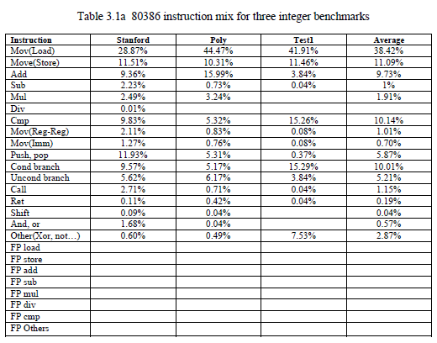
Results from benchmarks

Slide 32
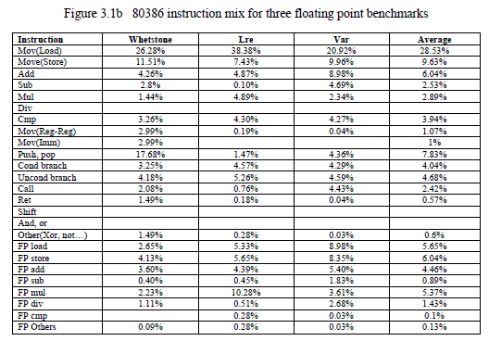
(CONT.)

Slide 33
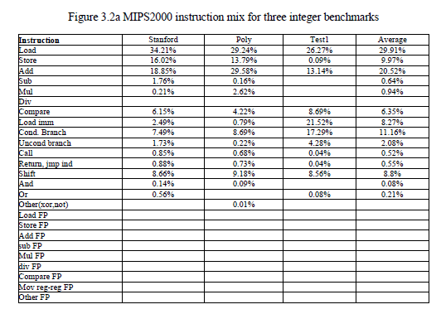
(CONT.)

Slide 34
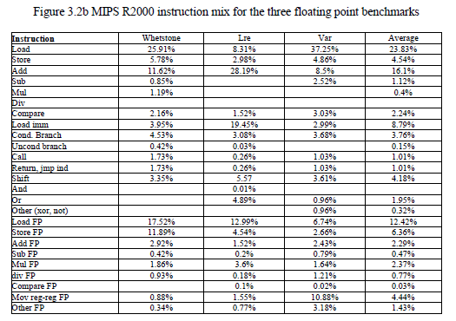
(CONT.)

Slide 35
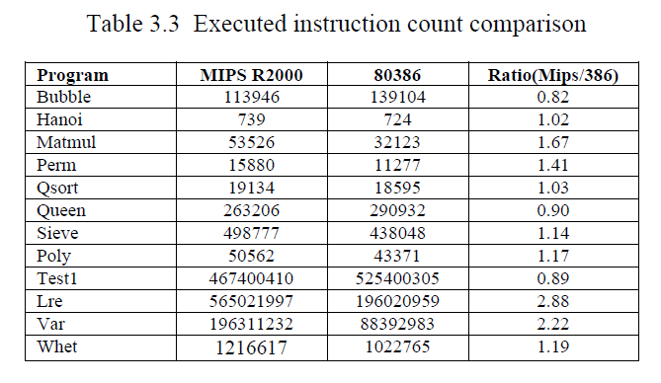
Instruction Count
Results:
Ratio 1.0 means that MIPS R2000 executes fewer instructions then 80386.

Slide 36
Instruction Format and Coding
For MIPS R2000, every instruction is 32bits (4 bytes) long with a fixed 6
bits opcode.
It has 4 categories of formats:
3. Branch
2. Register-immediate
1. Register-Register
4. Jump/call

Slide 37
Instruction Format and Coding
Register-Register:
Register-immediate:
Op(6) | Rs1(5) | Rs2(5) | Rd(5) | Const(5) | Opx(6)
Op(6) | Rs1(5) | Rs2(5) | Const(16)

Slide 38
Instruction Format and Coding
Branch:
Jump/call:
Op(6) | Rs1(5) | Opx(5) | Const(16)
Op(6) | Const(26)

Slide 39
instruction format of the 80386
The instruction encoding in 80386 is complex, with many different instruction formats.
Instruction may vary from one byte, where there are no operands, to up to 17 bytes long.
Table 3.5a shows the instruction formats for 80386.

Slide 40
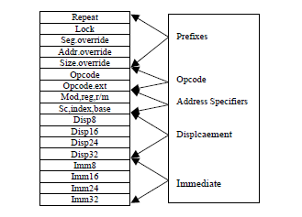
instruction format of the 80386

Slide 41
Addressing modes
MIPS R2000, it has only two kinds of addressing modes:
It accesses memory only through load/store instruction, to other instructions, the
operands come from registers.
Register indirect
Immediate

Slide 42
Addressing modes
To 80386, the operand types of 1st and 2nd operand can be like below:
R, R
R, Imm
R, Mem
Mem, R
Mem, Imm

Slide 43
It support 7 data memory addressing modes:
80386 has 11 addressing modes in total, some are below:
Absolute
Register indirect
Based
Indexed
Based indexed with displacement
Based with scaled indexed and displacement

Slide 44
Data Traffic

Slide 45
Continue..
The debate between RISC and CISC will likely continue, even if the battle
lines are now becoming fuzzy. This seems clear, no matter what your
RISC or CISC persuasion. But the future might not bring victory to one
of them, but makes both extinct.
So, Who wins?
No one wins.

Slide 46
conclusions
IC in 80386 is less than MIPS R2000, but not very much (average ratio < 2)
CISC has richer Instruction set, but in our case, the programs just use around 15% of all the instructions
CISC has better code density, 80386’s average instruction length is less than MIPS R2000’s
80386 has richer addressing modes, but in both integer and floating-point case, 3 addressing modes used for about 90%’s addressing, some addressing modes even never used
To 80386, the operand types can be “Memory”, while in MIPS R2000, only load/store will access memory, all operands are in registers. Cache and memory designer should be aware of this difference.

Slide 47
Who Wins?
The difference between RISC and CISC chips is getting smaller and smaller.
RISC and CISC architectures are becoming more and more alike. Many of today's RISC chips support just as many instructions as yesterday's CISC chips.
Here maybe we can simply say that RISC and CISC are growing to each other in their architecture in the theoretical point of view.

Slide 48
Continue..
In reality, what counts is how fast a chip can execute the instructions it is given and how well it runs existing software. Today, both RISC and CISC manufacturers are doing everything to get an edge on the competition. In 90's, most new generations of processors employ a mixed bag of architectural features, including multiple execution units, pipelining, caches, and floating-point integration, thus makes performance comparisons almost useless outside of a specific application.

Slide 49
Continue..
Finally, They point out that the biggest threat for CISC and RISC might not be each other, but a new technology called EPIC. EPIC stands for Explicitly Parallel Instruction Computing.
EPIC is a created by Intel and is in a way a combination of both CISC and RISC.

Slide 50
Continue..
From our limited experience based on the results of our benchmarks, it appears that theoretically the pure RISC machine such as MIPS R2000 is a more promising style of computer design
Compared to Intel 80386 CISC Chip at that era. With time fleeting, however, the bottom line between CISC and RISC becomes blur, in real world, people only care about how well a system can serve them.

Slide 51
Thank You!!!

